Slide 1
Point and Click Yahtzee
Java the Hutt
Ryan Gavino, Cameron Williamson, Dominic Orsi, Conner Deide

Slide 2
Project Overview
Project Problem:
We were asked to implement a multiplayer yahtzee game with a GUI
Main Features:
Player Name Choice
Quit Button
Preview Scorecard
4 person playable
Limitations were
Java swing
TIME!
Dominic’s mac
Assumptions were that
Can wrap all singleplayer features into a player class and ship it as multiplayer

Slide 3
Project Requirements
Making Sure a Single Player’s Turn Works
Made sure that just the core single player worked
Without this, the game doesn’t work
Once a player’s turn ends, it moves on to the next one
Wanted to make the game run without the need for a refresh button
Used listeners to accomplish this
When the Last Player’s Scorecard is Filled, a Winner is Declared
Automatically after the last scorecard is filled, a pop up appears with the winners points value

Slide 4
Project Solution Approach
How did we approach the GUI?
Single frame, rotating between the player components
What game/ui features did you really identify and work towards in your take on Yahtzee?
Player rotation
Connecting a color to a player

Slide 5
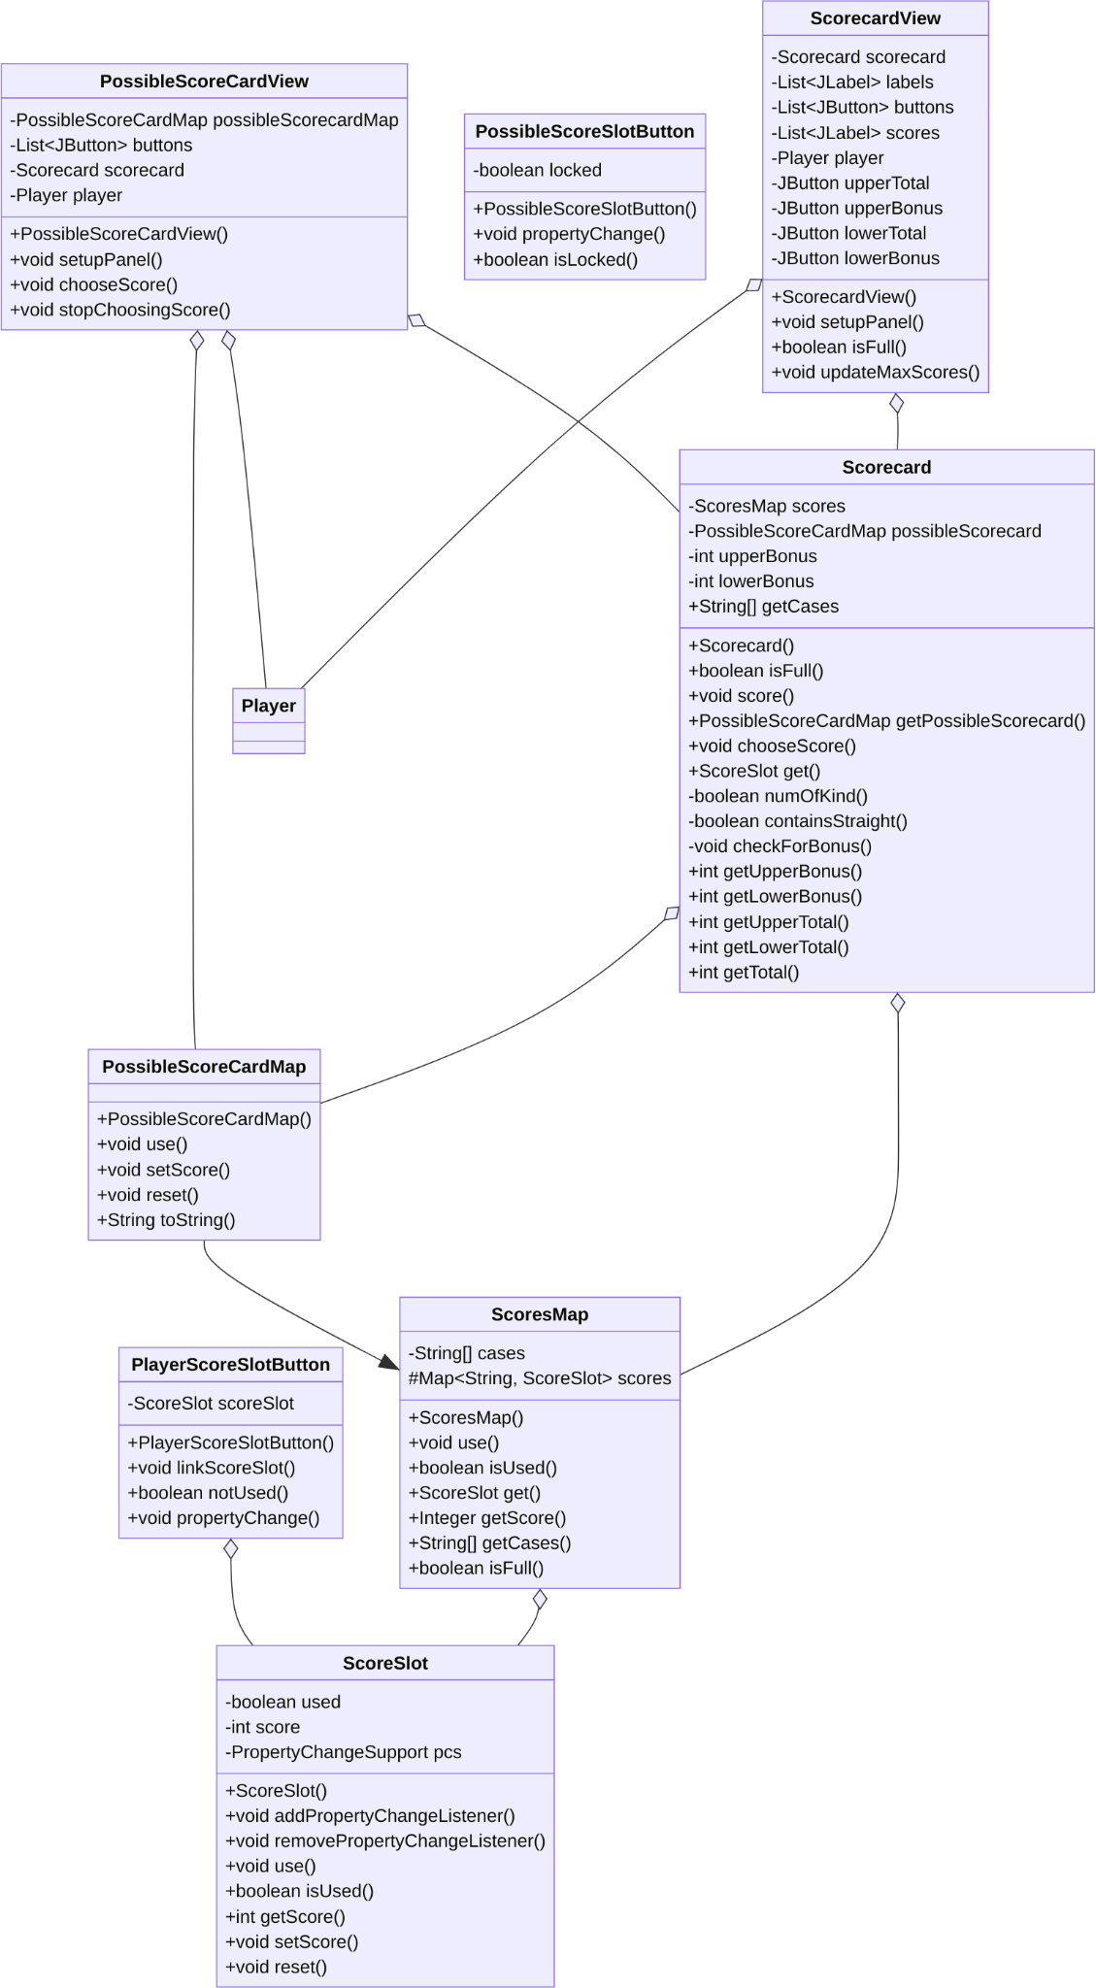
Scorecard UML Design

Slide 6
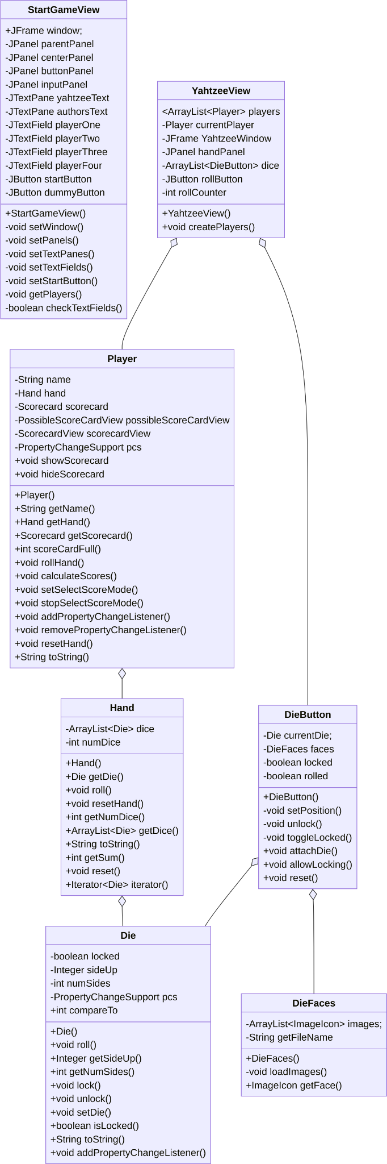
Remaining UML Design

Slide 7
Team Collaboration Approaches
How did we collaborate?
Used Discord for meetings and just general communication
Used webhook integration to see issues
Git Issues
Kept us on schedule
Easy to see what work was left to do and what was done
Git Branches
Helped keep work separate
Coding as a group is hard, getting separate code to work together is hard
Mostly coded separately but had one group crunch time hacking session

Slide 8
Testing, Validation, and Acceptance Plan
What testing approaches do you plan on using?
Unit tests
Written by user who writes that source code
Integration tests
Written by the people combining work
Functional tests
Manually checking each field/box/button is working properly
User tests
Manually trying to break the game
What’s the #1 way you’ll be able to say “Our project is deliverable”?
By passing all our tests, even the lint test …
Having a smooth playback experience
Notes:
Function test: two people present and checking over the game
User Tests: Manually trying to break the game, hit buttons in wrong order, and so forth

Slide 9
Live Demo Time
Let’s up it works

Slide 10
Summary
What Did We Learn?
That coding in a group is fun but also hard with all the moving parts
Git issues/branches are your friend
Yahtzee isn’t as scary as it seems
Mac’s like to mess up, a lot, or it’s user error
Key Takeaways:
Use the git workflow: it works!
Every issue can be made broken down into smaller ones

